Slide 1
How to Save Your Game in Kodu

Slide 2
Click Save My World
Click Here

Slide 3
Name Your Game & Save
Name Your Game
Click Save

Slide 4
Click Exit to Main Menu
Click here

Slide 5
Click Load World
Load Your World

Slide 6
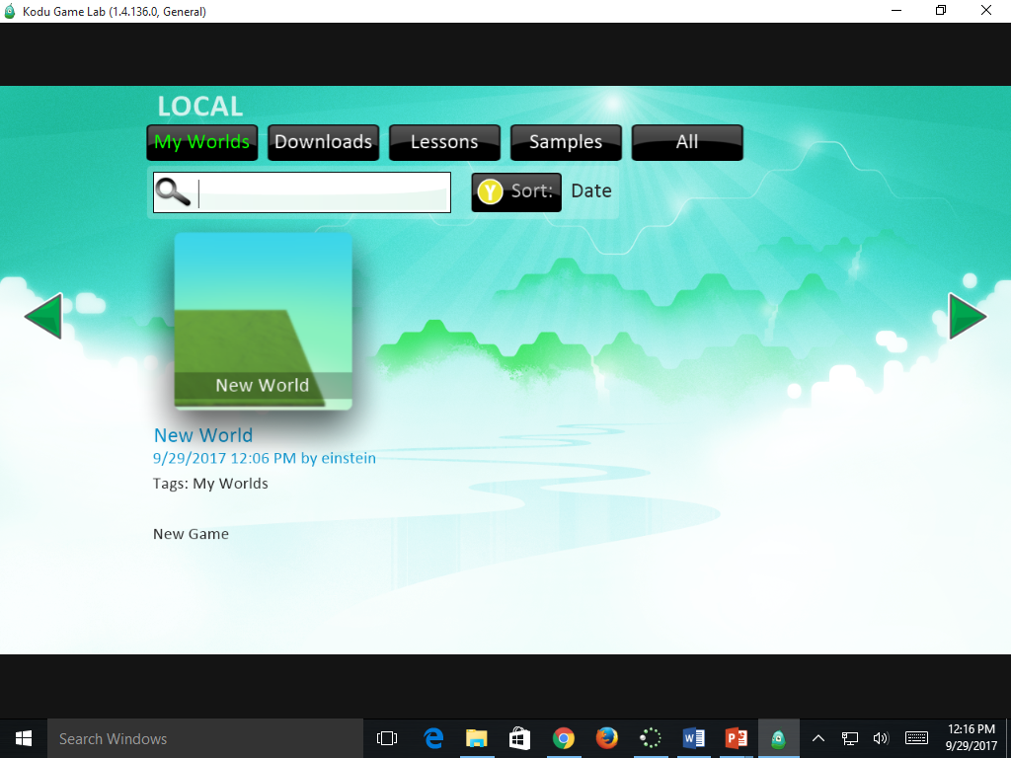
Choose Your Game
Click on Your Game

Slide 7
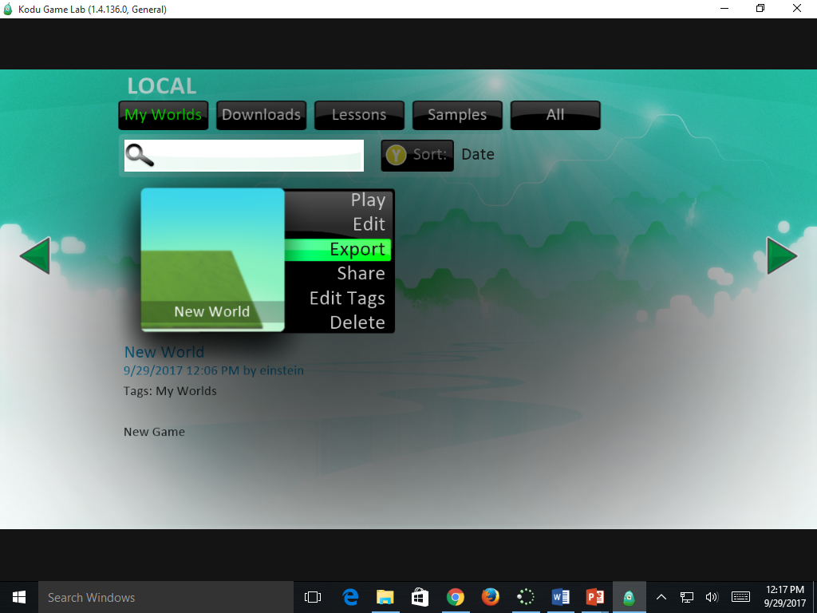
Click Export
Click Here

Slide 8
Name & Save to YOUR Learner’s Drive
Save to YOUR Learner’s Drive

